Slide 1
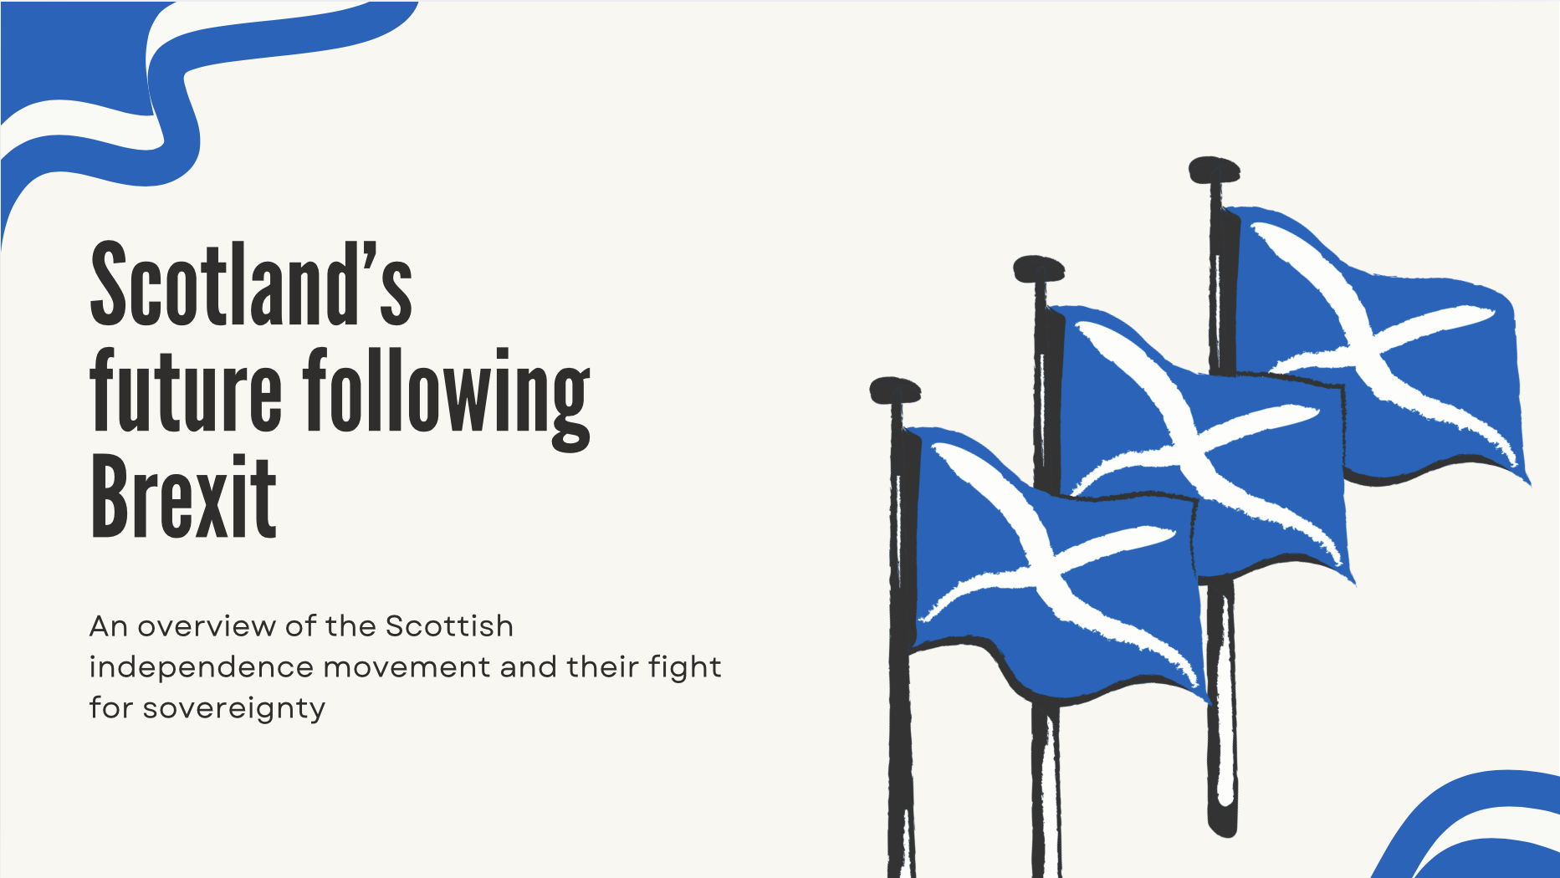

Slide 2
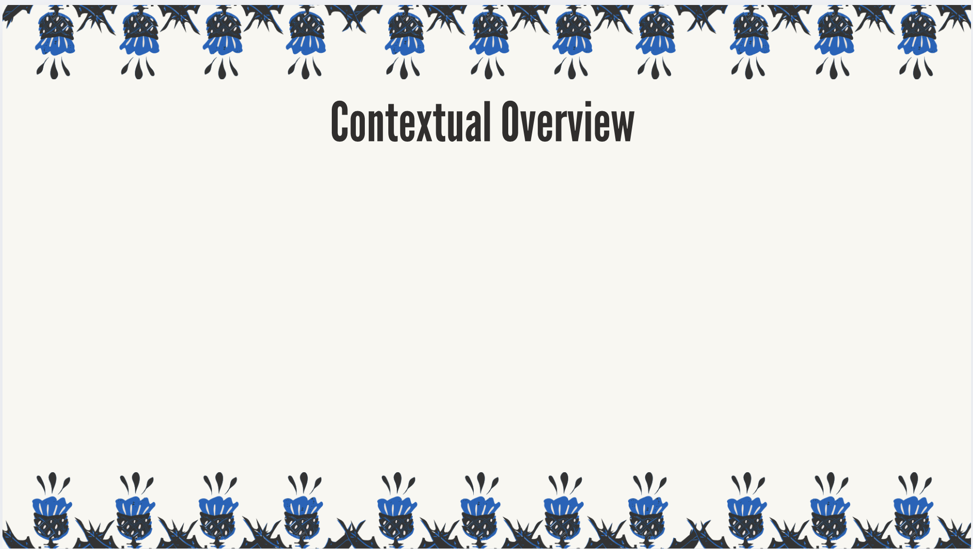
WHO: The Scottish Independent movement (made up of citizens + political leaders), United
Kingdom Parliament and European Union officials.
WHAT: Cameron won reelection in 2015, and immediately began renegotiating the UK’s
Relationship with the EU. His proposed referendum passed by a slim 51.9% to 48.1%; North Ireland
And Scotland being 2 nations that voted in favor to stay in the EU. In 2016, the UK decided to leave the EU,
Yet Scotland felt they were being forcibly removed.
WHERE: The United Kingdom + Scotland
WHEN: Following Brexit 2016, Scotland announced that it would be attempting to gain independency from
The UK. As of today, the nation has been unsuccessful in claiming their sovereignty.
WHY: The nation felt there’s be drastic economic effect with Brexit; cultural pride played a part in this decision too
Notes:
WHO: The Scottish Independent movement (made up of citizens + political leaders), United
Kingdom Parliament and European Union officials.
WHAT: Cameron won reelection in 2015, and immediately began renegotiating the UK’s
Relationship with the EU. His proposed referendum passed by a slim 51.9% to 48.1%; North Ireland
And Scotland being 2 nations that voted in favor to stay in the EU. In 2016, the UK decided to leave the EU,
Yet Scotland felt they were being forcibly removed.
WHERE:
WHEN:
WHY:

Slide 3
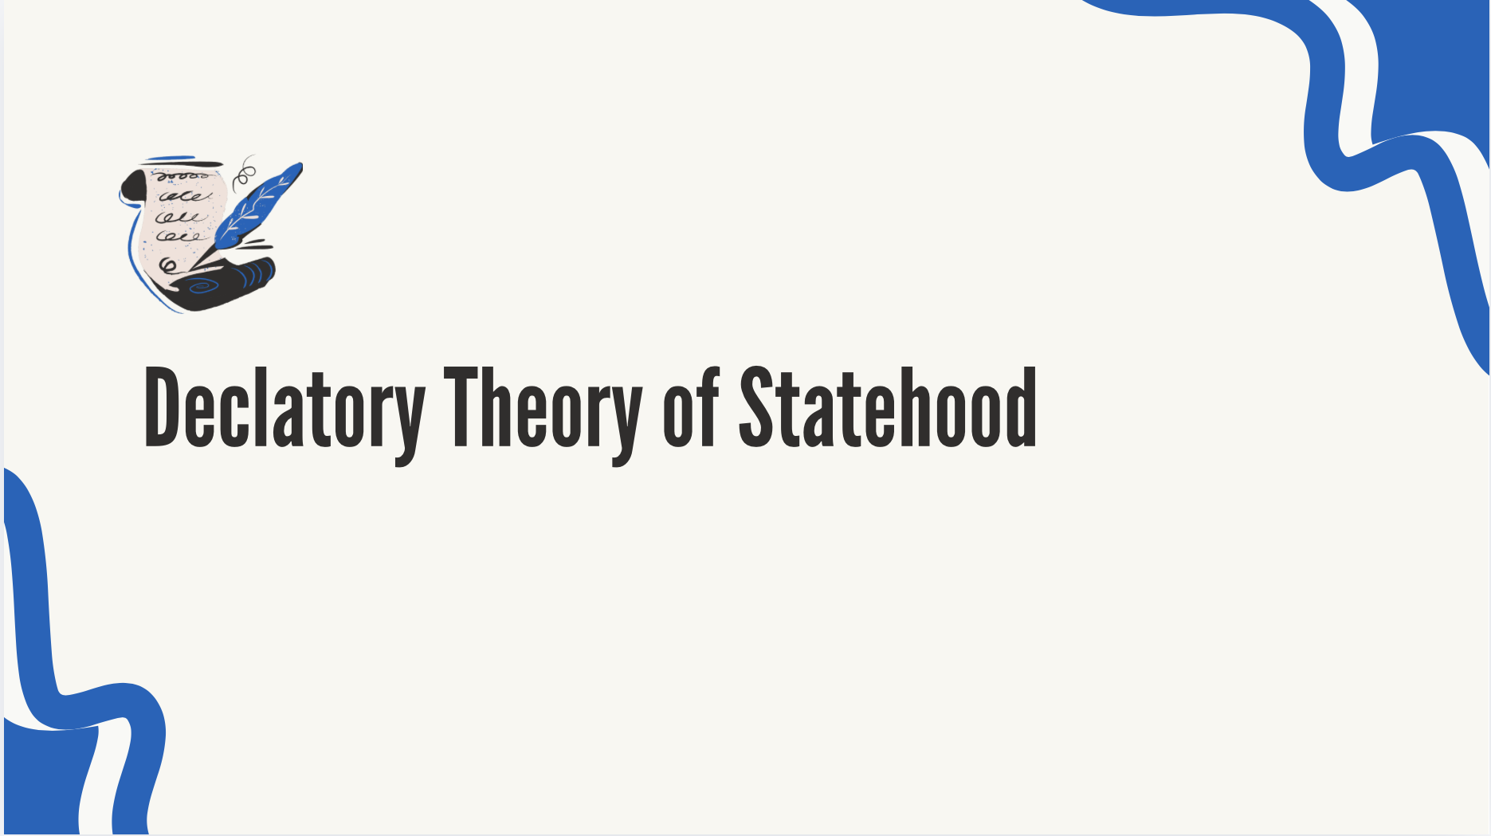
-Scotland meets 2 out of the 4 requirements to be considered a sovereign nation.
- Having a permanent population, defined territory and border.
-Scotland falls shorts when it comes to being able to have relations with other states and by having a devolution shared government with the UK.
-Therefor Scotland is unqualified to be a sovereign nation.
Notes:
Do they meet the declaratory theory of statehood requirements? If so, explain. If not, which areas have they fallen short?
Scotland does meet 2/4 requirements with having a permanent population with over 5.5 million people Migrartion being the main driver of the popultion. Scotland also has a 96 mile border shared with England. This border is considered a soft border meaning people are aloud to come in w/o a passport. Moving on the reason Scotland falls short is because they are not able to have realtions w/ other states. Under the Scotland act of 1998 the Scotland govt has authority over internal matters but cannot sign international treaties. Scotland does have an active and functioning government but its shared with the uk and that means it doesn’t meet the criteria for the declatory theory of statehood. This means that Scotland is not qualified to be a sovergn nation.
Scotland qualifies mostly with domestic soverignty because it aligns with the modern mainstream, political vision for Scotland. The reason scoland wouldn’t qualify for the other level levels of soverignty because they are still apart of the UK making it hard to be independent or more.

Slide 4
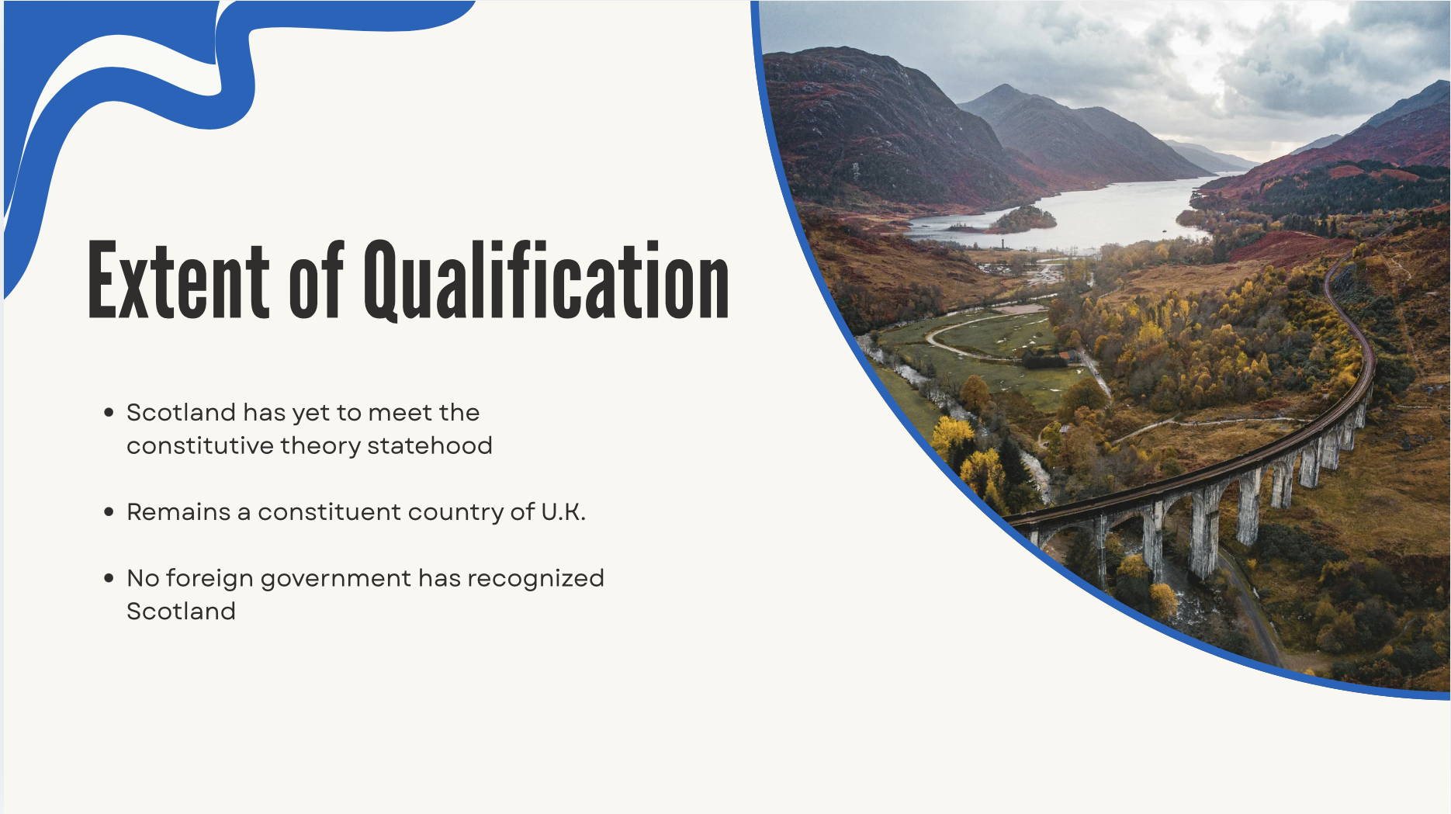
Notes:
To what extent has Scotland met the conststuitive theory of statehood.
Scotland has not met the constitutive theory of statehood because it is not recognized as an independent, sovereign state by the international community.
Under international law, the constitutive theory dictates that a entity only becomes a state when it is officially recognized by other existing states.

Slide 5
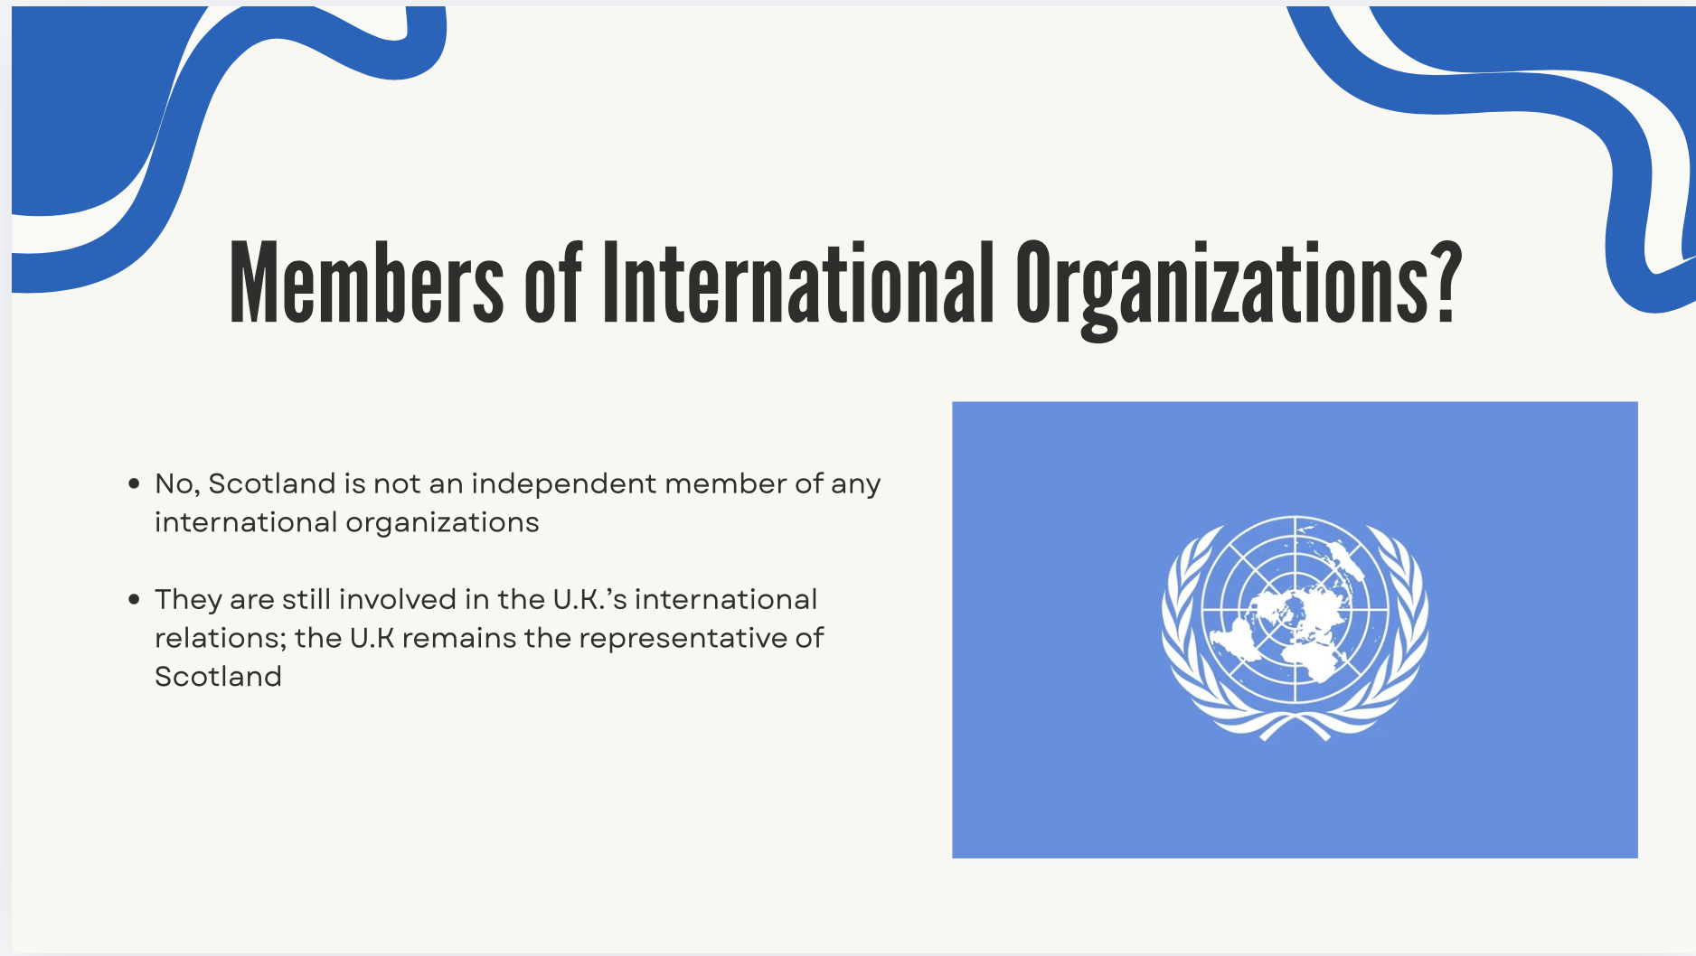

Slide 6
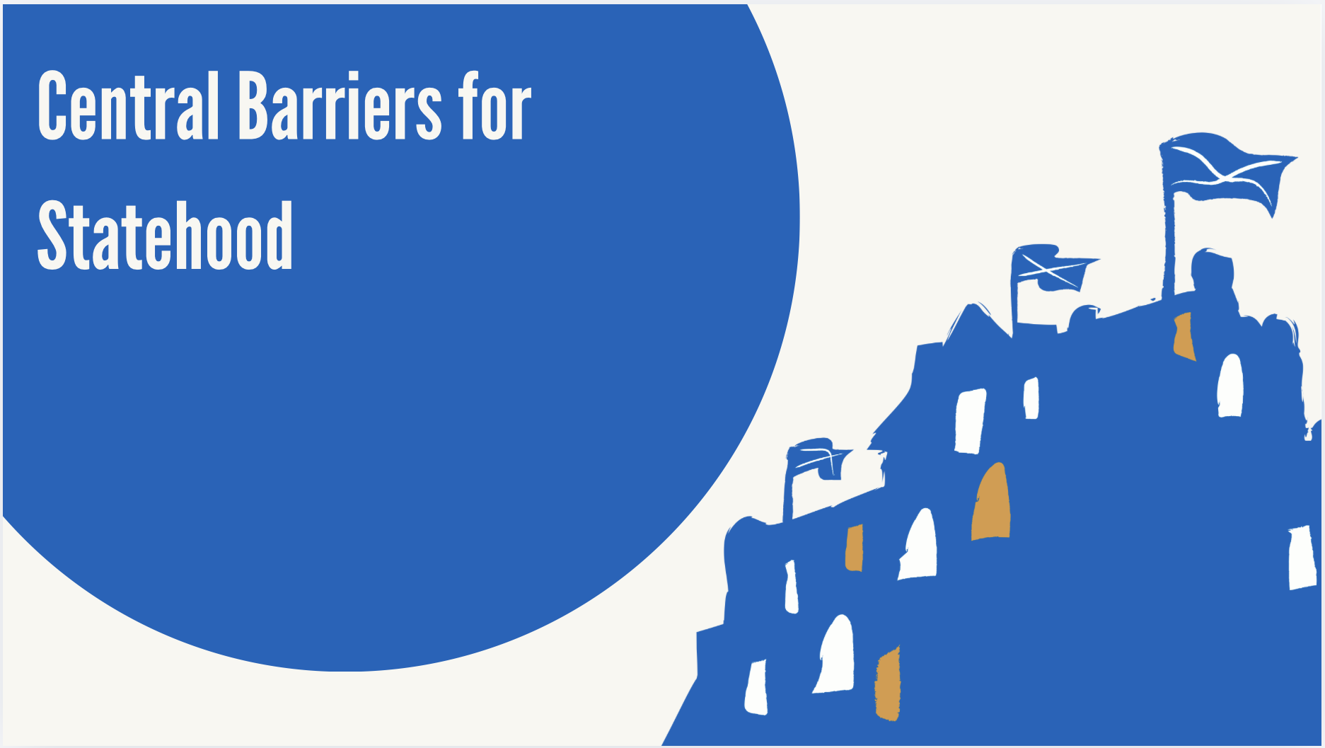
1st barrier: Scotland is not recognized as a sovereign nation but it is instead the UK who represents them globally
2nd barrier: Scotland does not possess the exclusion of external actors, this is because while they do have their own government that is capable of managing internal structures, the ultimate legal sovereignty remains with the UK Parliament
3rd barrier: While Scotland has their own government, effective authority and power to decide laws, the UK is able to change these and they control things like foreign affairs

Slide 7
Works Cited
“Brexit: The Future of Northern Ireland and Scotland.” Council on Foreign Relations, Council on Foreign Relations, www.cfr.org/event/brexit-future-northern-ireland-and-scotland
Duffy, Reuben. “The Politics of Scotland’s Autonomous Foreign Policy.” The Constitution Society, 14 Aug. 2025, consoc.org.uk/the-politics-of-scotlands-autonomous-foreign-policy/.
Solly, Meilan. “A Not-so-Brief History of Scottish Independence.” Smithsonian.Com, Smithsonian Institution, 30 Jan. 2020, www.smithsonianmag.com/history/brief-history-scottish-independence-180973928/.
“The History behind Brexit.” History.Com, A&E Television Networks, 28 May 2025, www.history.com/articles/the-history-behind-brexit.
“Welcome to National Records of Scotland.” National Records of Scotland (NRS), www.nrscotland.gov.uk/

